Slide 1

NPDES Electronic Reporting Rule
Implementation Overview
Webinar: http://epawebconferencing.acms.com/nerw/
Webinar Audio: Participants can use their computer speakers for the webinar audio or call the following toll-free number:
Ph: (888) 659-0695 / Conference ID: 1514077
EPA Regional and State Webinar
2 November 2016

Slide 2
Webinar Details
EPA is using two webinars to present important information on the NPDES Electronic Reporting Rule implementation. The topics for these two webinars are generally grouped as:
November 2nd – Phase 1 Implementation
November 9th – Phase 2 Implementation
Due to the expected large number of participants, we are muting all lines except the line for the EPA presenter.
Listeners can use the webinar ‘chat box’ to send in questions or comments. We will be monitoring the ‘chat box’ and help people with any webinar connection issues. We will collect all questions and comments.
We have reserved time at the end of the second webinar specifically for questions and answers.

Slide 3
Webinar Details
EPA is recording the webinars and will be posting the videos to our new website. A transcript will also be provided for each video.
Questions and comments on NPDES electronic reporting as well as training requests for EPA’s NetDMR and NeT should be directed to the NPDES Electronic Reporting Helpdesk at:
NPDESeReporting@epa.gov OR 1-877-227-8965

Slide 4
Agenda – Webinar 1
Introductions and Overview of NPDES Electronic Reporting Implementation
Overview of New NPDES Electronic Reporting Rule Website
Quick demonstration of NPDES Electronic Reporting Rule website
Overview of new online NetDMR training (Captivate)
NPDES ID Lookup Tool for NPDES electronic reporting (Mock-ups)
NetDMR-CDX Integration Schedule
Schedule and coordinating tasks for NetDMR integration with CDX
EPA Support for NetDMR (Training Support, Help Desk)
Demo of streamlined NetDMR registration
Update on Federal Biosolids Annual Report (40 CFR 503)
Introduction and demonstration of Federal Biosolids Annual Report and deployment schedule
Plan for collecting biosolids pollutant concentration data
Overview of training and outreach plan for Federal Biosolids Annual Report

Slide 5
Agenda – Webinar 1
Non-Major Compliance Tracking in ICIS-NPDES and ECHO
Proposed changes in ECHO and ECHO Gov for non-major DMR non-receipt tracking and quarterly compliance status
Overview of forthcoming EPA guidance memo on non-major DMR non-receipt tracking, quarterly compliance status, and updated process for “Permit Major/Minor Status Indicator” data element
NetDMR-CDX Integration Schedule
Schedule and coordinating tasks for NetDMR integration with CDX
EPA Support for NetDMR (Training Support, Help Desk)
Demo of streamlined NetDMR registration
Update on State Readiness for Phase 1 NPDES Electronic Reporting Rule Implementation
Demonstration of “NPDES Electronic Reporting Readiness and Data Completeness Dashboard” in ECHO Gov
Review of information gathered from EPA-state calls on Phase 1 NPDES Electronic Reporting Rule implementation
Overview of how EPA will assess electronic reporting participation rates (June 2017)

Slide 6
Agenda – Webinar 2
ECHO Implementation of New Search Features and Reports for NPDES Sectors
Demonstration of Industrial Stormwater search ECHO showing EPA’s Multi-Sector General Permit (MSGP) data
Example wireframes showing ideas for searching and displaying data from Federal Biosolids Annual Report
Overview of Regulations Governing NPDES Electronic Reporting Waivers
Update on EPA’s ECHO Unpermitted CAFO Data Masking
Review of masking criteria and deployment schedule
Demo of ECHO Gov search showing masked unpermitted CAFOs
Update on Phase 2 NPDES Electronic Reporting Rule Implementation
Update on Initial Recipient status and the ‘Opt-Out’ process
Overview of collaborative process for developing Phase 2 data elements and electronic reporting forms
Update on EPA-State Sewer Overflow Technical Workgroup
Update on EPA’s Construction General Permit (CGP) schedule and wireframes

Slide 7
Agenda – Webinar 2
Phase 2 Implementation Plan
Overview and purpose of the Phase 2 Implementation Plan
Details on how to submit these plans to EPA
EPA’s anticipated schedule for reviewing and providing comments on these plans
Public access to these plans and process for updating these plans
Questions and Answers (Covering Both Webinars)

Slide 8
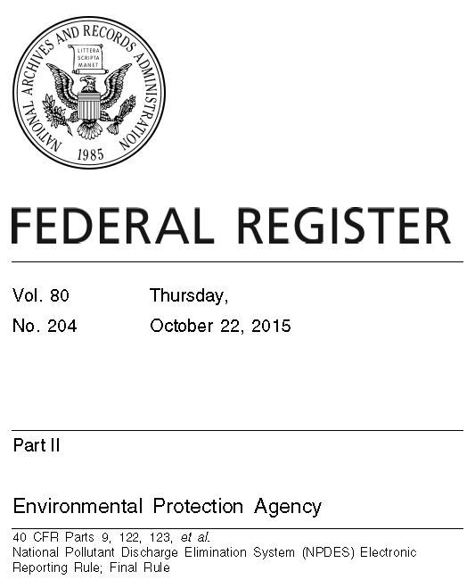
NPDES Electronic Reporting
On 22 October 2015, EPA publish a rule that will help EPA and states protect our nation’s waters, by:
Bringing the NPDES Program into the 21st Century by shifting from paper to electronic reporting. Final rule establishes no new reporting requirements for regulated entities.
Saving money and time for the regulated community and for states (reduce data entry time, improve accuracy).
Improving transparency and freeing state and EPA resources to focus on the most important problems.
Using technology to obtain more accurate, timely, and complete information about the NPDES program.

Slide 9

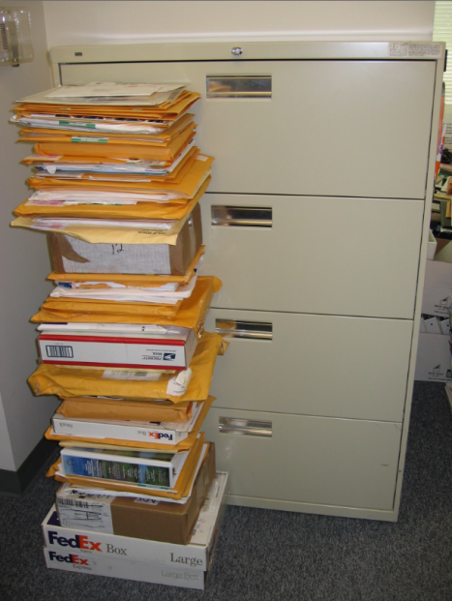
EPA Region 9 Annual Pretreatment Reports
EPA Region 7 Annual Biosolids Reports

Slide 10
More Efficient Data Submissions
 | Existing NPDES Program Reporting | 40 CFR
Data from NPDES Permittees | Discharge Monitoring Reports (DMRs) – Phase 1 | 122.41(l)(4)(i)
 | General Permit Reports (NOI, NOT, NECs, LEWs) – Phase 2 | 122
 | Biosolids Annual Program Reports – Phase 1 (EPA only) & Phase 2 (8 states w/ auth.) | 503
 | CAFO Annual Program Reports – Phase 2 | 122.42(e)(4)
 | MS4 Program Reports – Phase 2 | 122.34(g)(3), 122.42(c)
 | Pretreatment Program Annual Reports – Phase 2 | 403.12(i)
 | Industrial User Compliance Reports in Municipalities Without Approved Pretreatment Programs – When EPA or State is Control Authority – Phase 2 | 403.12(e) & (h)
 | Sewer Overflow Event Reports (CSOs, SSOs, Bypass events) – Phase 2 | 122.41(l)(6), (7), (m)
 | CWA 316(b) Annual Reports (Federally Listed Threatened or Endangered Species) – Phase 2 | 40 CFR 125 Subpart J
Data from States | Require electronic reporting by NPDES-authorized states, territories, tribes, and Regions of program implementation information (permits, inspections, violations, and enforcement actions) | 123.41 & 123.43
 | Eliminate requirements for the annual state biosolids annual report, semi-annual statistical summary report, phase out state burden for ANCR and QNCR submissions, and rename and modify terms defining Category I and Category II noncompliance to reflect the new data sources | 123.45, 501.21

Slide 11
EPA’s Electronic Reporting Tools
EPA has two tools for electronically collecting permit related documents and compliance monitoring information.
These tools are available for states to use for their implementation of the NPDES Electronic Reporting Rule.
NetDMR – Used for the collection of Discharge Monitoring Report (DMR) forms.
NPDES Electronic Reporting Tool (NeT) – Used for the collection of all other NPDES forms and information.

Slide 12
Partnering with States: Implementation
Phase 1 – DMR Submissions & Biosolids Reports (21 Dec 2016)
EPA will work with states to bring their adoption rates above 90% through:
Individualized outreach plans and assistance (currently with 46 State programs and the Virgin Islands territory); and
Training and assistance for states to implement EPA’s electronic reporting tools and data exchange protocols.
Biosolids Annual Program Reports is in Phase 1 where EPA runs the Federal biosolids program (42 states).
Phase 2 – General Permit and Program Reports (21 Dec 2020)
Work with states to bring their adoption rates above 90% through:
Review and approval of state implementation plans (due 21 Dec 2016); and
Making new a new electronic reporting tool (NeT) available to states for general permits and program reports.
EPA has identified contractor and financial assistance for states to implement e-reporting, pending resources.

Slide 13
Partnering with States: Implementation
EPA is working with states to develop and test the forms necessary for electronic reporting.
For example, EPA worked with 10 states and EPA HQ and Regional biosolids experts to develop the biosolids annual report form.
Nearly 100 testers (EPA Regions, States, POTWs) helped with the testing of this new biosolids annual report form in August and September 2016.
EPA will provide outreach and training for registration and form completion (December through February) after form deployment.
EPA will also work with states on how these data will be displayed in EPA’s public access site called ECHO (https://echo.epa.gov).
EPA has started work on Phase 2 electronic reporting and is currently working with EPA Regions and States to develop the form for sewer overflow report (which is currently reported under 40 CFR 122.41).

Slide 14
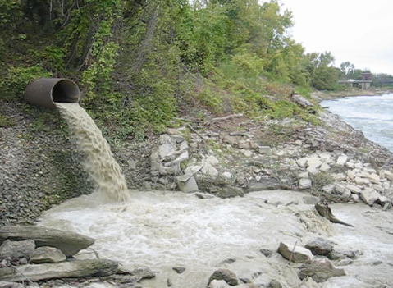
Questions, Comments, Requests....
Questions and comments on NPDES electronic reporting as well as training requests for EPA’s NetDMR and NeT should be directed to the:
NPDES Electronic Reporting Helpdesk
NPDESeReporting@epa.gov
(877) 227 – 8965

